Slide 1


Institute Of Engineering & Technology Khandari Campus, Agra
1
Department Of Computer Secience & Engineering

Slide 2


Real Time Human Pose Estimation
PROJECT MEMBER:
Riya Dixit 1909005371041
Ravi Kumar Gupt 1909005371037
Rishabh Kumar Singh 1909005371039

Slide 3

CONTENTS
3
S.No | Topics | Page No
1. | Constraints | 4
2. | Introduction | 5
3. | Pose Estimation | 6-7
4. | Libraries | 8
5. | TensorFlow | 9
6. | Ml5 | 10-11
7. | P5 | 12-13
8. | Planning of work | 14-15
9. | Figma Design | 16-19
10. | Conclusion | 20

Slide 4
CONSTRAINTS
4
Pose estimation is a vast topic and considering their types (2D pose estimation and 3D pose estimation) we have restricted our project to the 2D pose estimation which is the estimation of keypoints of object/image along x and y coordinate.
On the other hand the implementation can also be done in several ways. But we will estimate the single and multi pose with the help of Web Browser.
Here we are not going to train the Machine Learning models, instead we will use java script libraries which have inbuilt capabilities of ML and just by using some import commands we will have access to those ML models.

Slide 5
Introduction
5
Real Time Human Pose Estimation is a task of using machine learning model to estimate the pose of a person from an image or a video by estimating the spatial locations of key body joints that is called keypoints.
This step is a crucial prerequisite to multiple tasks of computer vision which include human action recognition, human tracking, human-computer interaction, gaming, and video surveillance. Therefore, we present this synopsis to fill the knowledge gap and shed light on 2D human pose estimation.
A centre of attention is given on detecting the pose in browser using free open source in built TensorFlow libraries i.e., p5.js, ml5.js.

Slide 6
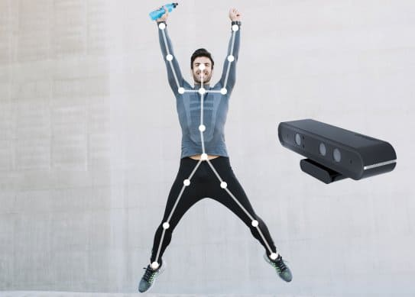
POSE ESTIMATION
6
Pose estimation is a computer vision task that infers the pose of a person or object in an mage or video. We can also think of pose estimation as the problem of determining the position and orientation of a camera relative to a given person or object.
Input: Image or video containing people.
Output: Key body joints pose.

Slide 7
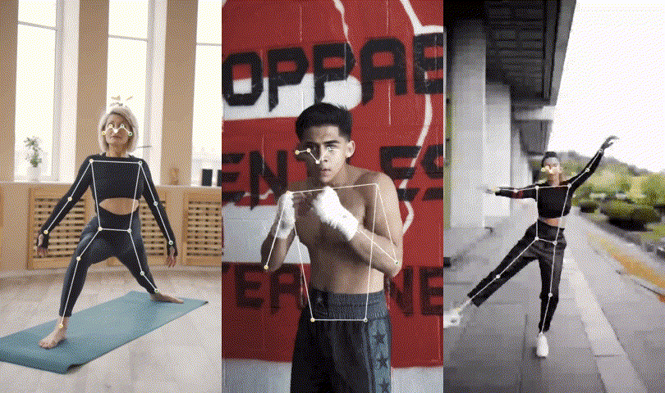
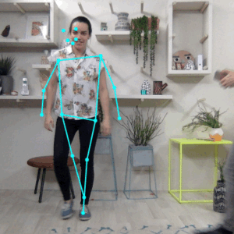
7
Pose Estimation can estimate either a single pose or multiple poses, meaning there is a version of the algorithm that can detect only one person in an image/video and one version that can detect multiple persons in an image/video.
Single Pose Estimation
Multi Pose Estimation

Slide 8
LIBRARIES
8
Following libraries we will use to implement the real time human pose estimation project using browser.
TansorFlow
Ml5.js
P5.js

Slide 9

1. TensorFlow
TensorFlow is an open-source machine learning framework for all developers. It is used for implementing machine learning and deep learning applications. To develop and research on fascinating ideas on artificial intelligence, Google team created TensorFlow. TensorFlow is designed in Python programming language, hence it is considered an easy-to-understand framework.
TensorFlow is a software library or framework, designed by the Google team to implement machine learning and deep learning concepts in the easiest manner. It combines the computational algebra of optimization techniques for easy calculation of many mathematical expressions.

Slide 10
2. Ml5.js
10
It is a java script library built on top of Tensorflow.js that provides access to various machine learning and deep learning algorithms within the browser. This library is intended to make machine learning accessible to the huge Java script community.
ml5.js uses Tensorflow.js API layer to easily define, train, and test models. ml5.js is an open source, friendly high-level interface to TensorFlow.js, a library for handling mathematical operations and memory management for machine learning algorithms.

Slide 11
Use Web-Based Machine Learning
11
The ability to make machine learning models in the browser is very useful as it can keep the data within the user’s browser only. The added bonus of being able to use webcams and microphones directly without using any external libraries as is the case with other languages makes it quite convenient.
<script src="https://unpkg.com/ml5@latest/dist/ml5.min.js">
</script>

Slide 12
3. P5.js
12
p5.js is a JavaScript library used for creative coding. It is based on Processing which is a creative coding environment. The main focus of processing is to make it as easy as possible for beginners to learn how to program interactive, graphical applications, to make a programming language more user-friendly by visualizing it.
The advantage of using the JavaScript programming language is its broad availability and ubiquitous support: every web browser has a JavaScript interpreter built-in, which means that p5.js programs can be run on any web browser.

Slide 13

Code in p5.js is called sketch which will show the following output as follows:
13
function setup() {
createCanvas(400, 400); //Canvas size 400*400
}
function draw() {
background('blue'); //background color blue
}

Slide 14
PLANNING OF WORK
14
These are steps that should be followed to achieve the real time human pose estimation in browser using different libraries.
1. Setting up dependencies
First, we need to install the dependencies needed for project.
import * as tf from "@tensorflow/tfjs";
import * as posenet from "@tensorflow-models/posenet";
import Webcam from "react-webcam";
2. Setup webcam and canvas
Next, we’re going to set up our webcam and a canvas:
const webcamRef = React.useRef(null);
const canvasRef = React.useRef(null);
3. Detecting the webcam.
Next, we need to create a function that grabs the video properties and handles the video adjustments.

Slide 15
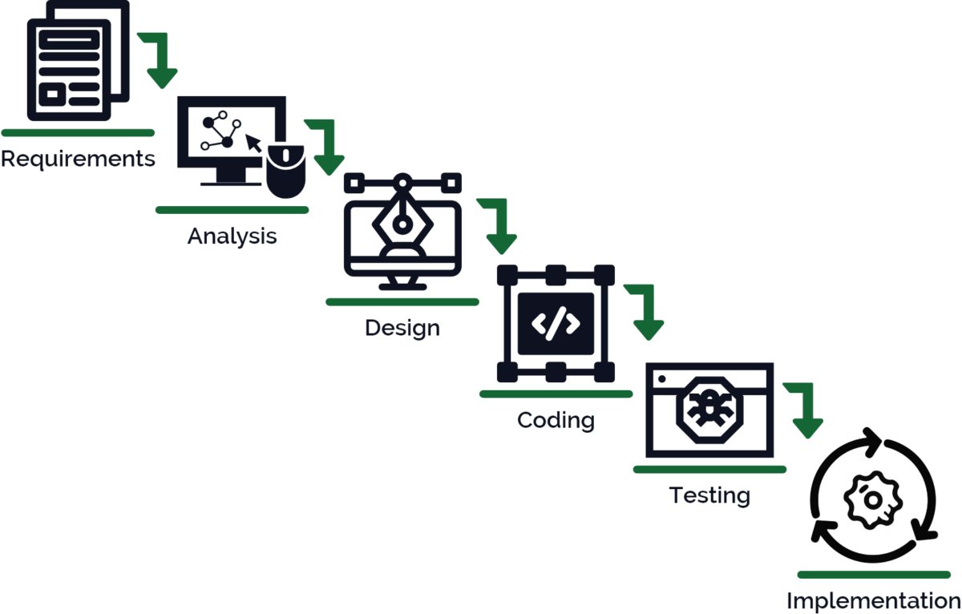
4. Loading the PoseNet model
In this step, we’re going to load the pre-trained PoseNet Model that we installed and imported earlier.
5. Drawing Utilities from TensorFlow
In this step, we are going to start drawing the pose estimation key points on our canvas in order to demonstrate that our model works well.
6. Draw functions
Here, we’re going to implement a function called draw Result that shows the pose estimation results on the canvas

Slide 16
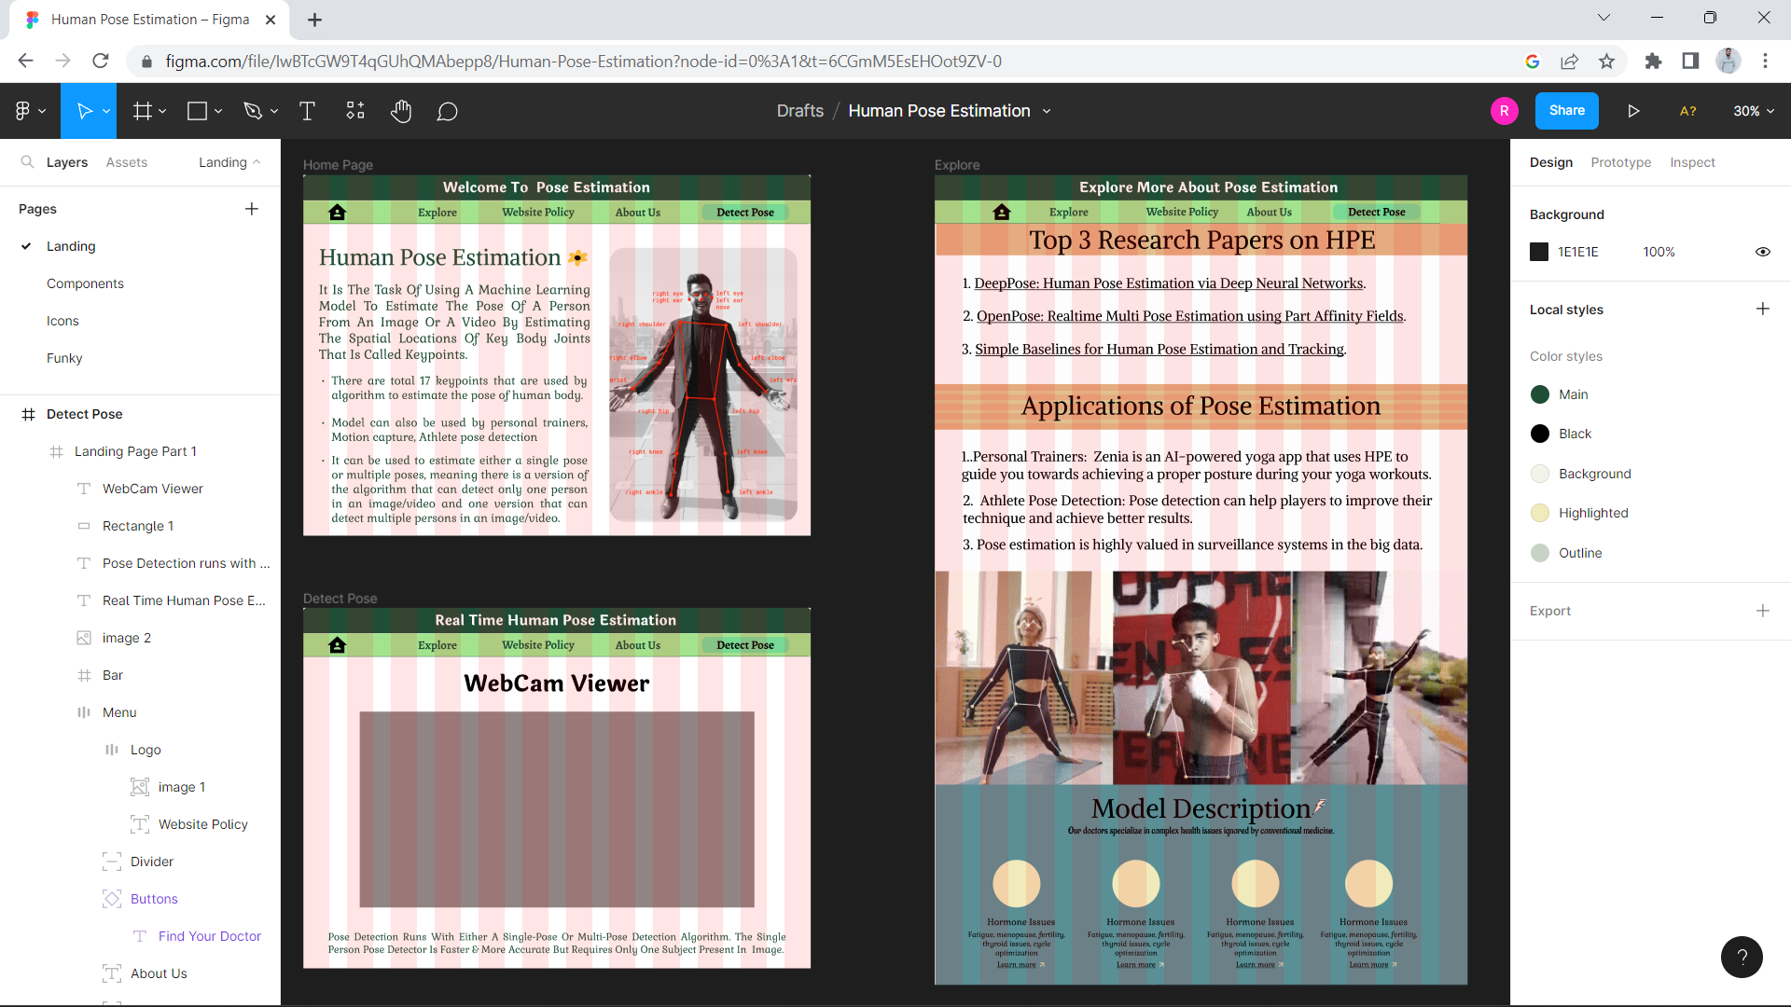
FIGMA DESIGN
16

Slide 17
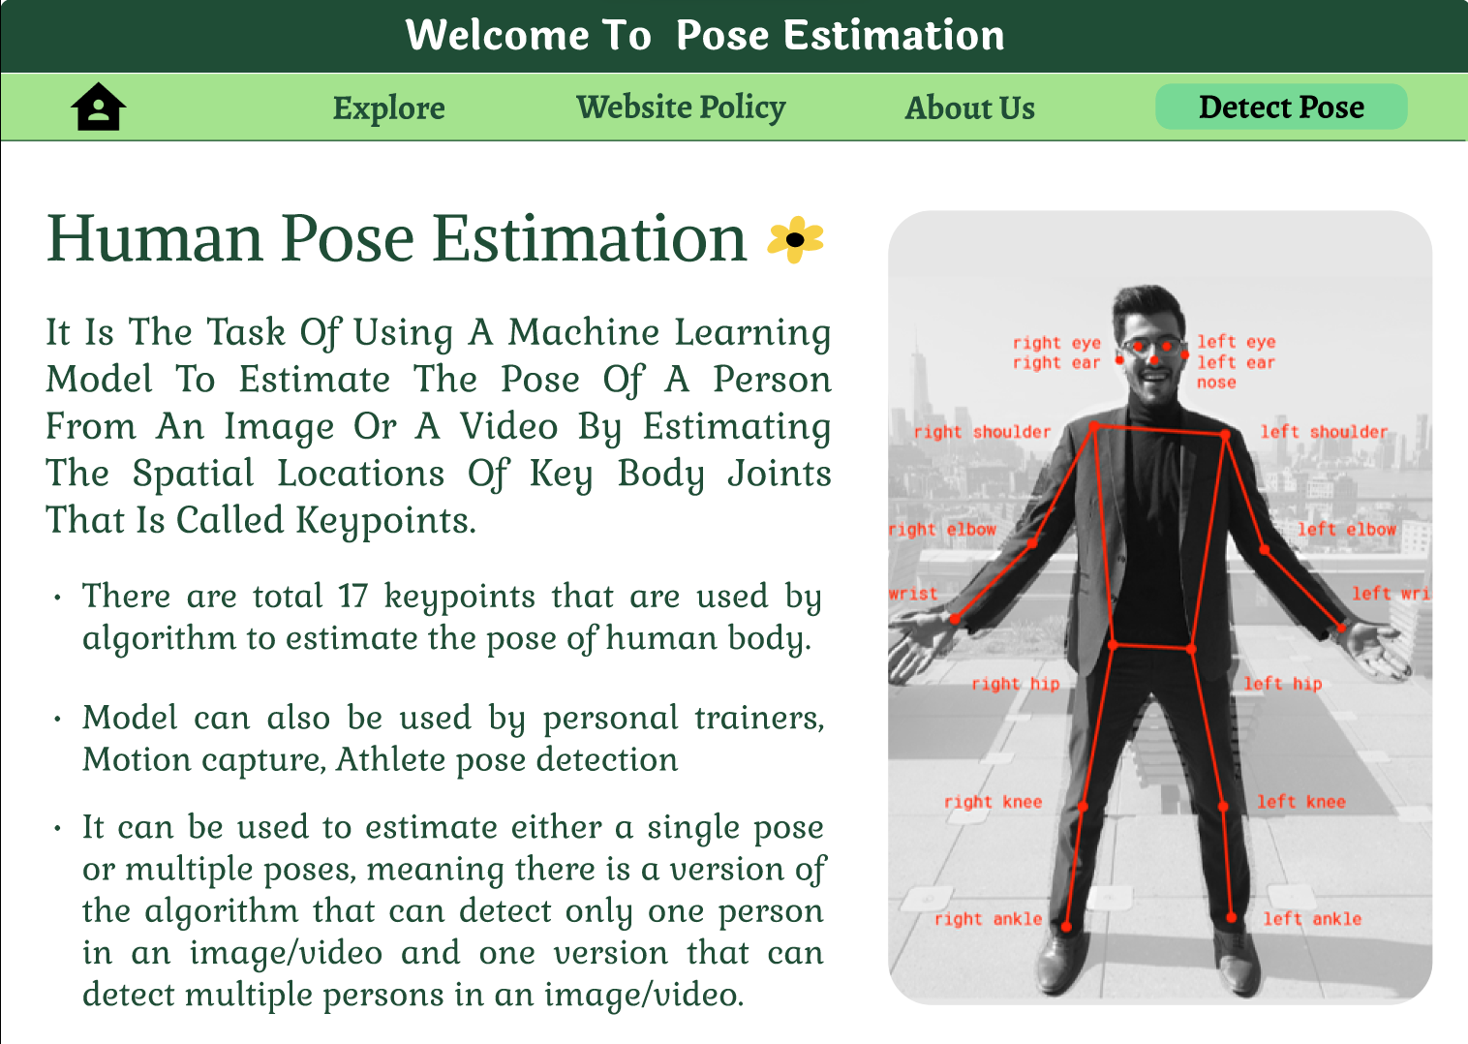
Page 1: Home Page
17

Slide 18
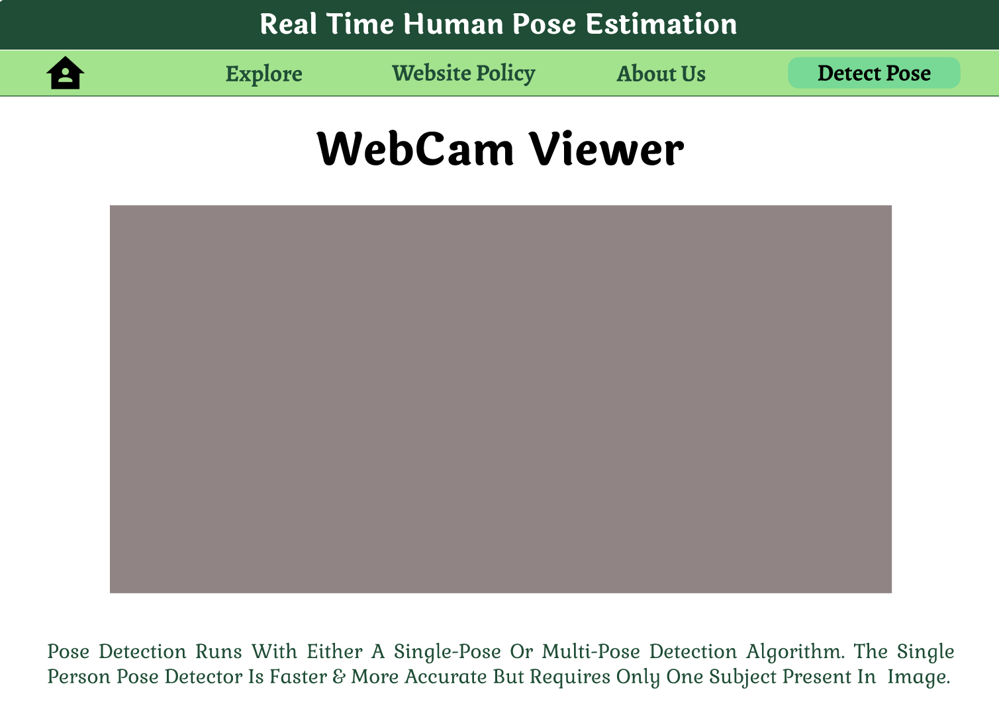
Page 2: For Estimating Poses
18

Slide 19
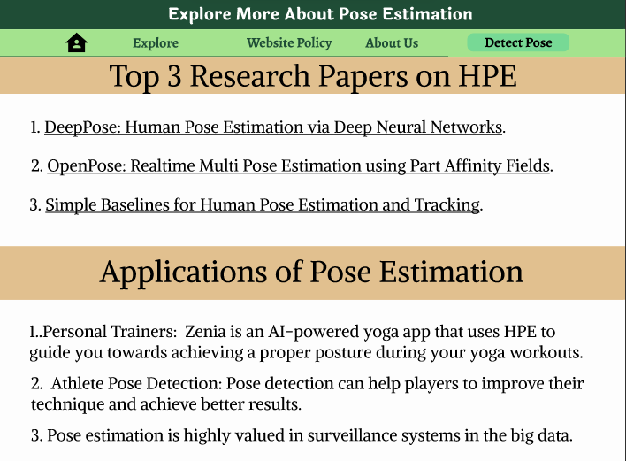
Page 3: Audience Awareness
19

Slide 20
CONCLUSION
20
The aim is to deliver the basic use cases of the Pose Net model for real-time human pose estimation using a webcam feed as the data. Now, the challenge is to create an advanced webcam filter that has detection functionalities that rival advanced tools like the Snapchat camera.
We selected the pose net model for our purpose and learned about its pros and cons over other models. Our aim is to set up the PoseNet model along with TensorFlow.js in a React project from the TensorFlow library.

Slide 21


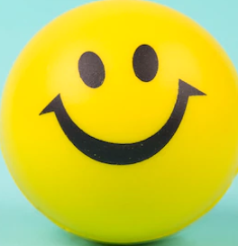
21
Thank
You

